Slide 1

Natural of progression of Agile Technical Practices
@MarkPearlCoZa

Slide 2

Skateboard
@MarkPearlCoZa
Notes:
Present from Parents

Slide 3

Skateboard
Notes:
Become a famous skateboarder

Slide 4

Skateboard
Notes:
10 seconds into the descent and 5 meters down the hill

Slide 5

Skateboard
Notes:
World went into slow motion

Slide 6
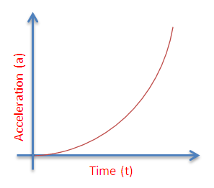
Notes:
Skateboarding & Software Development

Slide 7
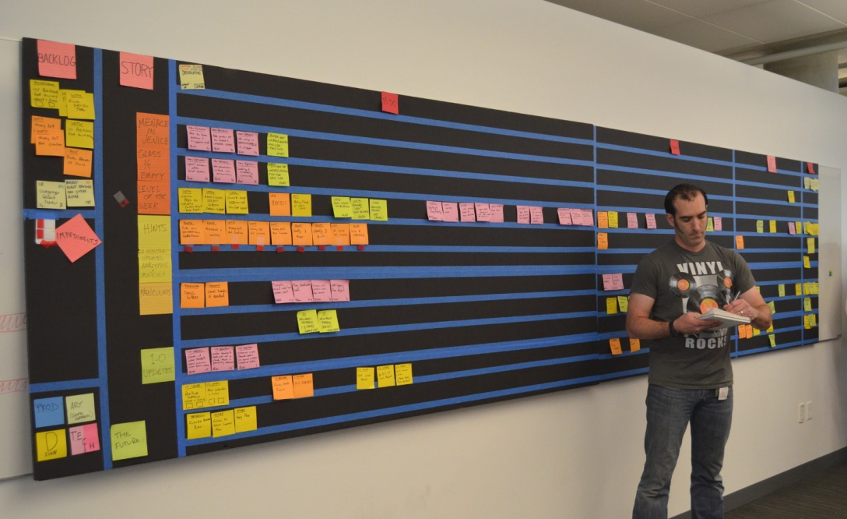

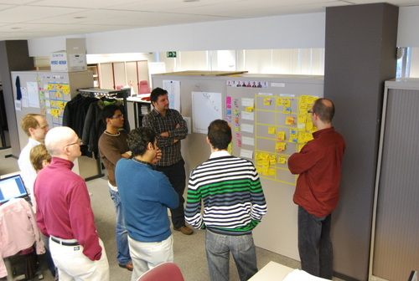
Notes:
Skateboarding & Software Development

Slide 8

Notes:
Skateboarding & Software Development

Slide 9
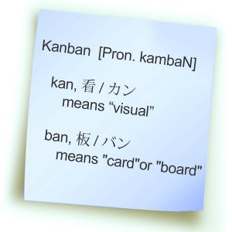
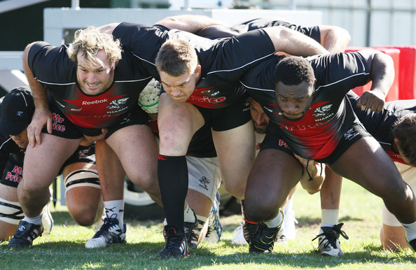

Slide 10

The natural order of agile technical practices

Slide 11
What are agile technical practices?

Slide 12
Test Driven Development, Behaviour Driven Development, Continuous Integration, Immunization, Common Coding Style, Automated Acceptance Testing, Pair Programming, Mob Programming, Code Reviews, Feature Toggles, Simple Design, Continuous Deployment, Effective Version Control, Keystoning, Refactoring

Slide 13


Slide 14
Engineering Practices and Team Structures are joined at the hip.

Slide 15
Slack

Slide 16
Prefer small regular intervals over large infrequent blocks

Slide 17
Encourage learning new things regularly.

Slide 18
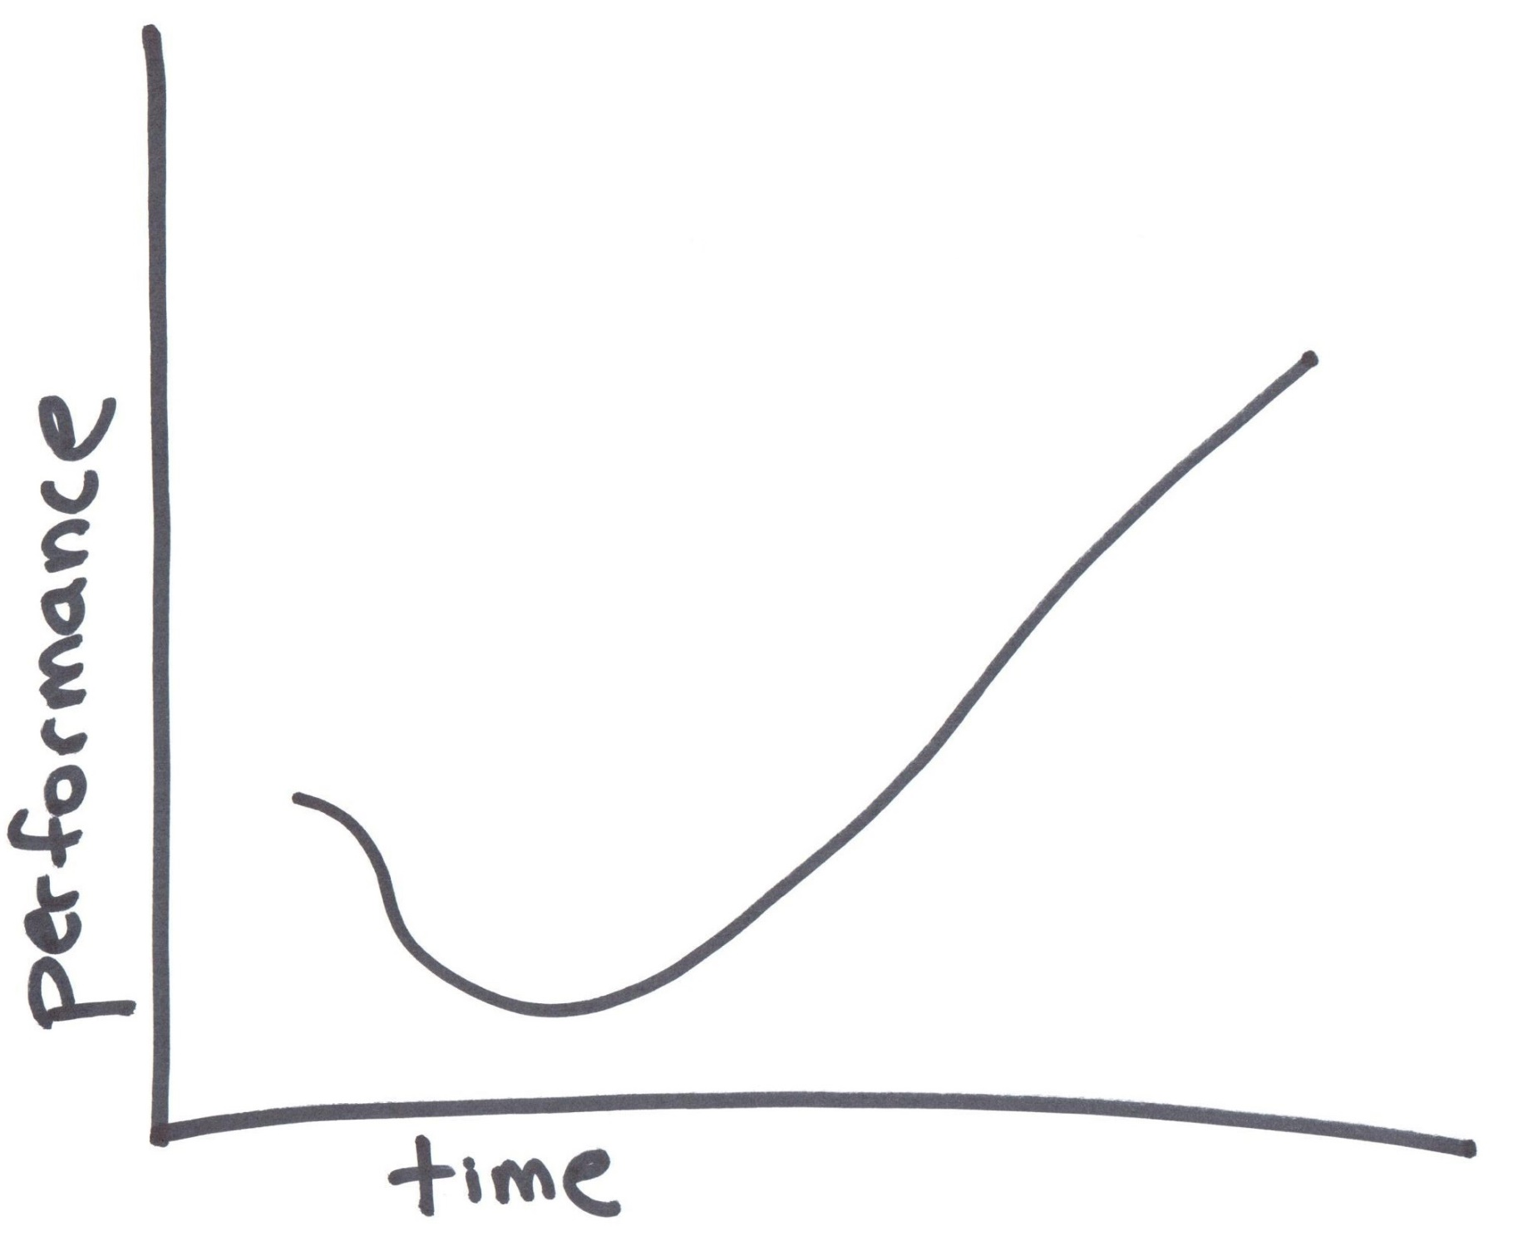
Notes:
Support the Dips

Slide 19

Notes:
We have deadlines!

Slide 20
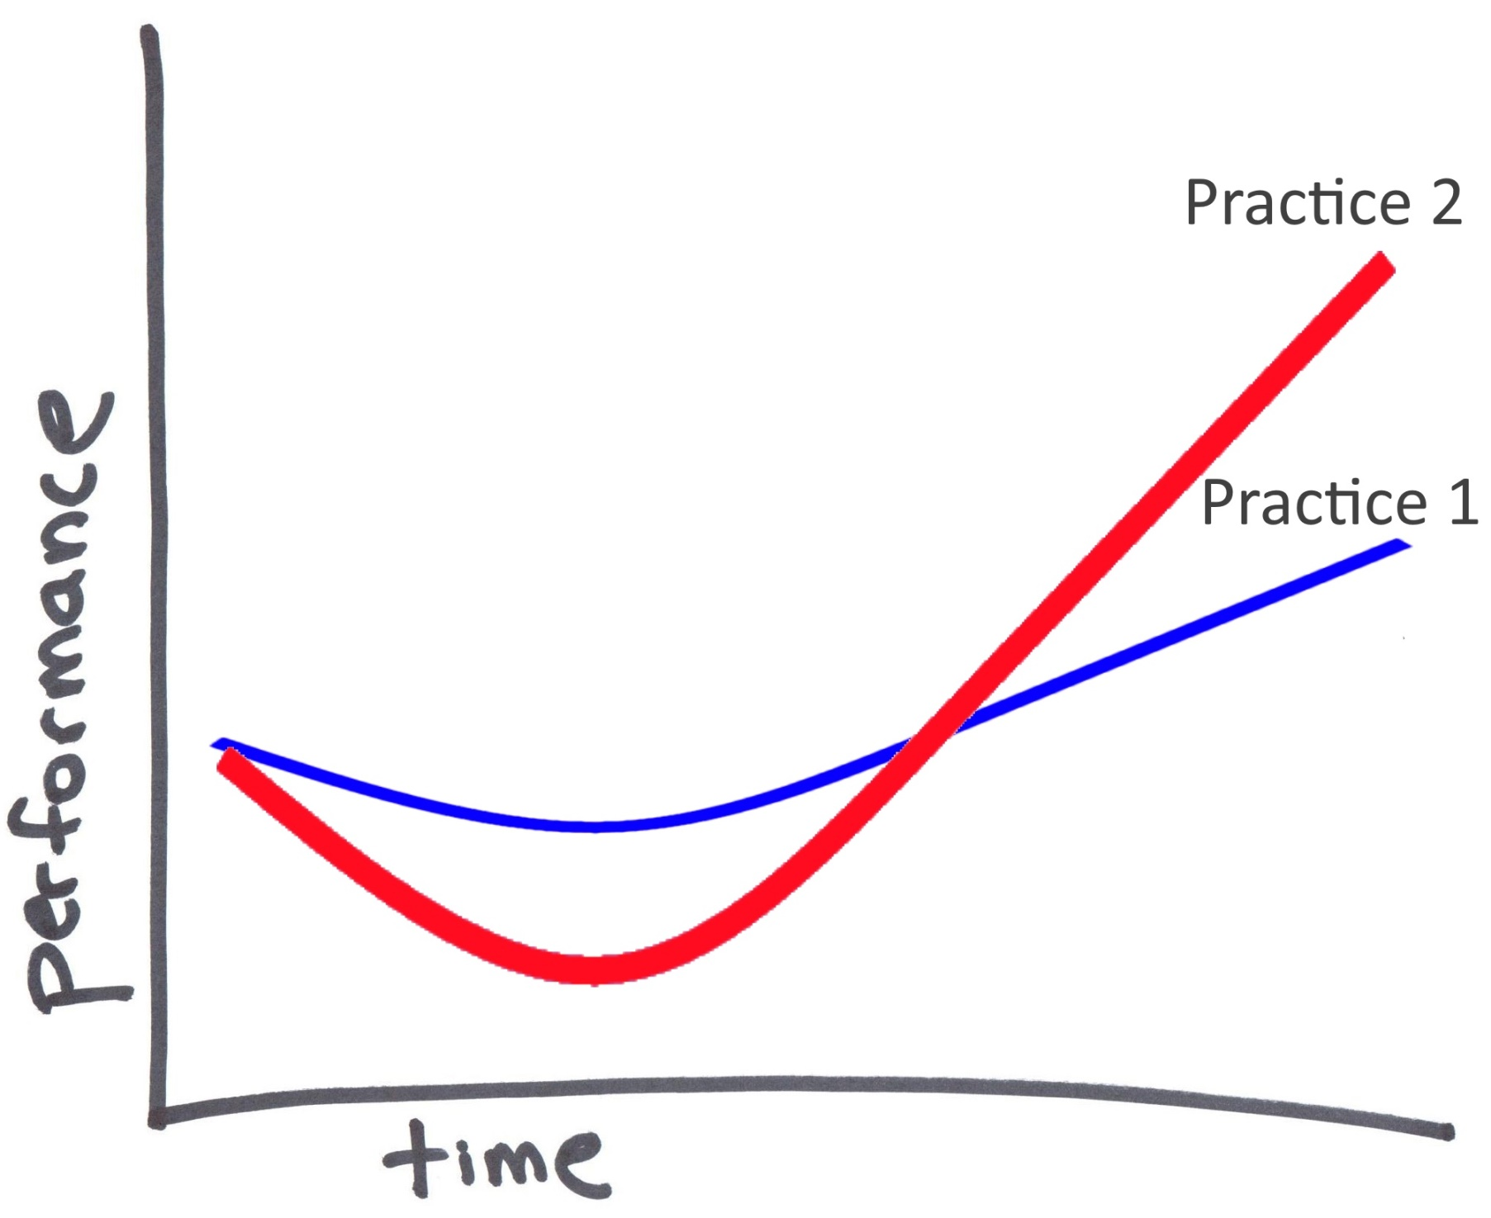

Slide 21
As a team: Identify the bottlenecks Identify practices that can help Pick an appropriate practice Learn and apply it

Slide 22


Slide 23
Effective use of Version Control

Slide 24
It’s not just a backup tool! It’s a really powerful integration tool

Slide 25


Slide 26


Slide 27
Do small little bits of work and merge or integrate frequently

Slide 28
Automate and Democratize the Build

Slide 29


Slide 30


Slide 31


Slide 32


Slide 33
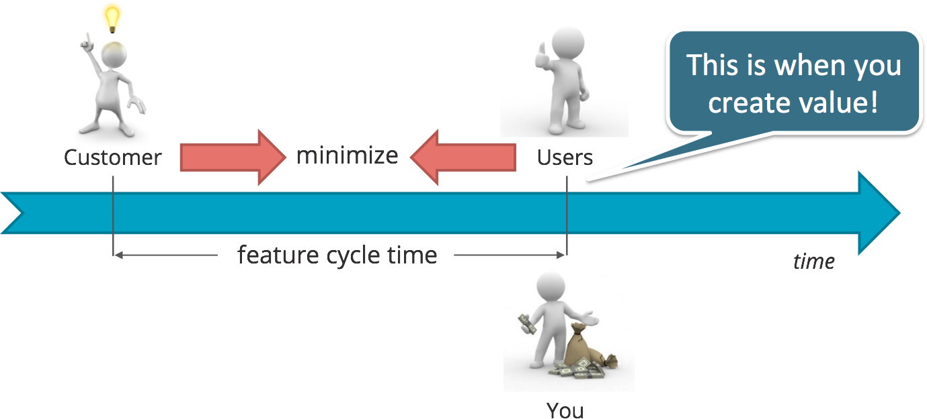

Slide 34
Make the Continuous Integration Server Visible

Slide 35


Slide 36
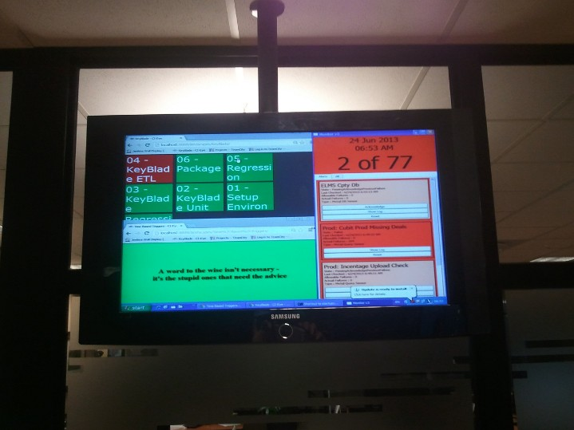

Slide 37
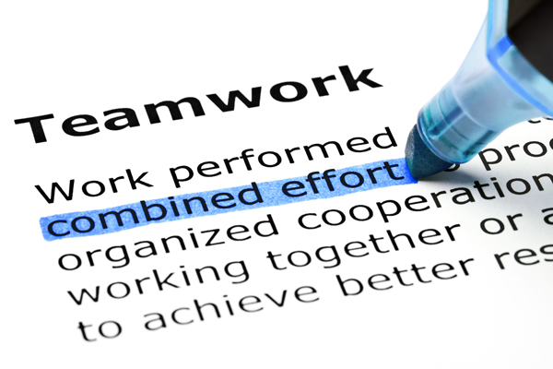

Slide 38
Code belongs to the project, not the individual

Slide 39
Common Team Code Style

Slide 40


Slide 41
Collaborative Coding

Slide 42

Collaborative Coding

Slide 43
What ??? Two or more people working together on one problem?

Slide 44
Programming is not about typing, it’s about problem solving

Slide 45
Test Driven Development

Slide 46
Automated Testing
Test Driven Development

Slide 47
Automated tests verify that a system is functioning as expected

Slide 48
Helps create a simple design, inspires confidence

Slide 49
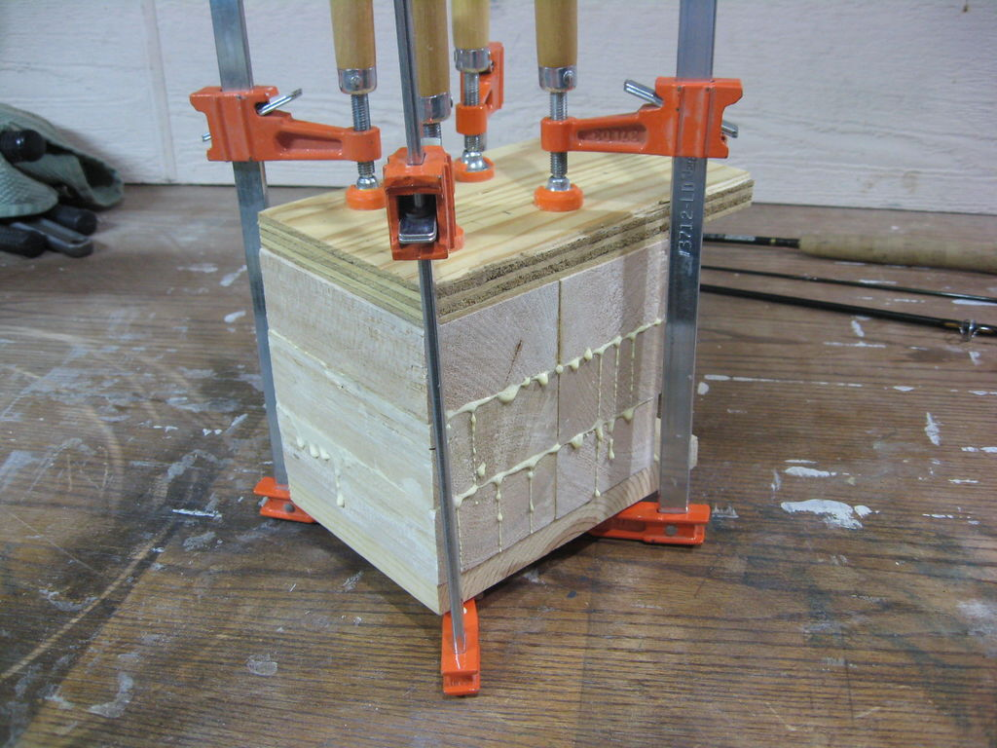

Slide 50
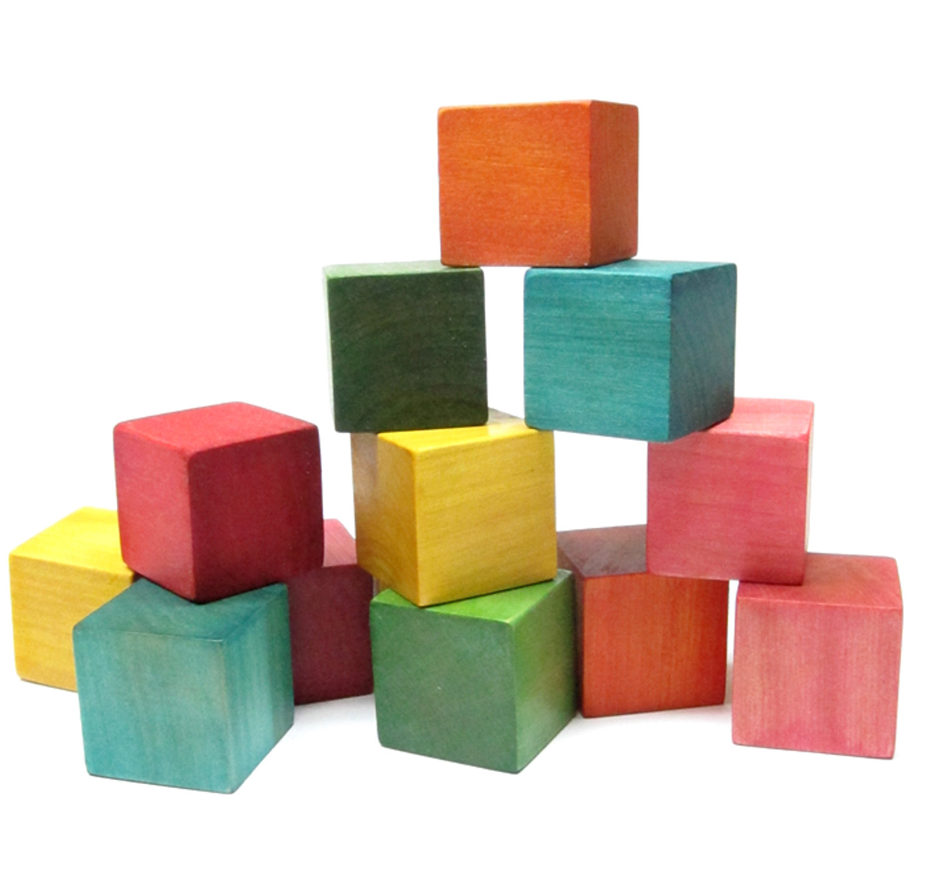

Slide 51


Slide 52
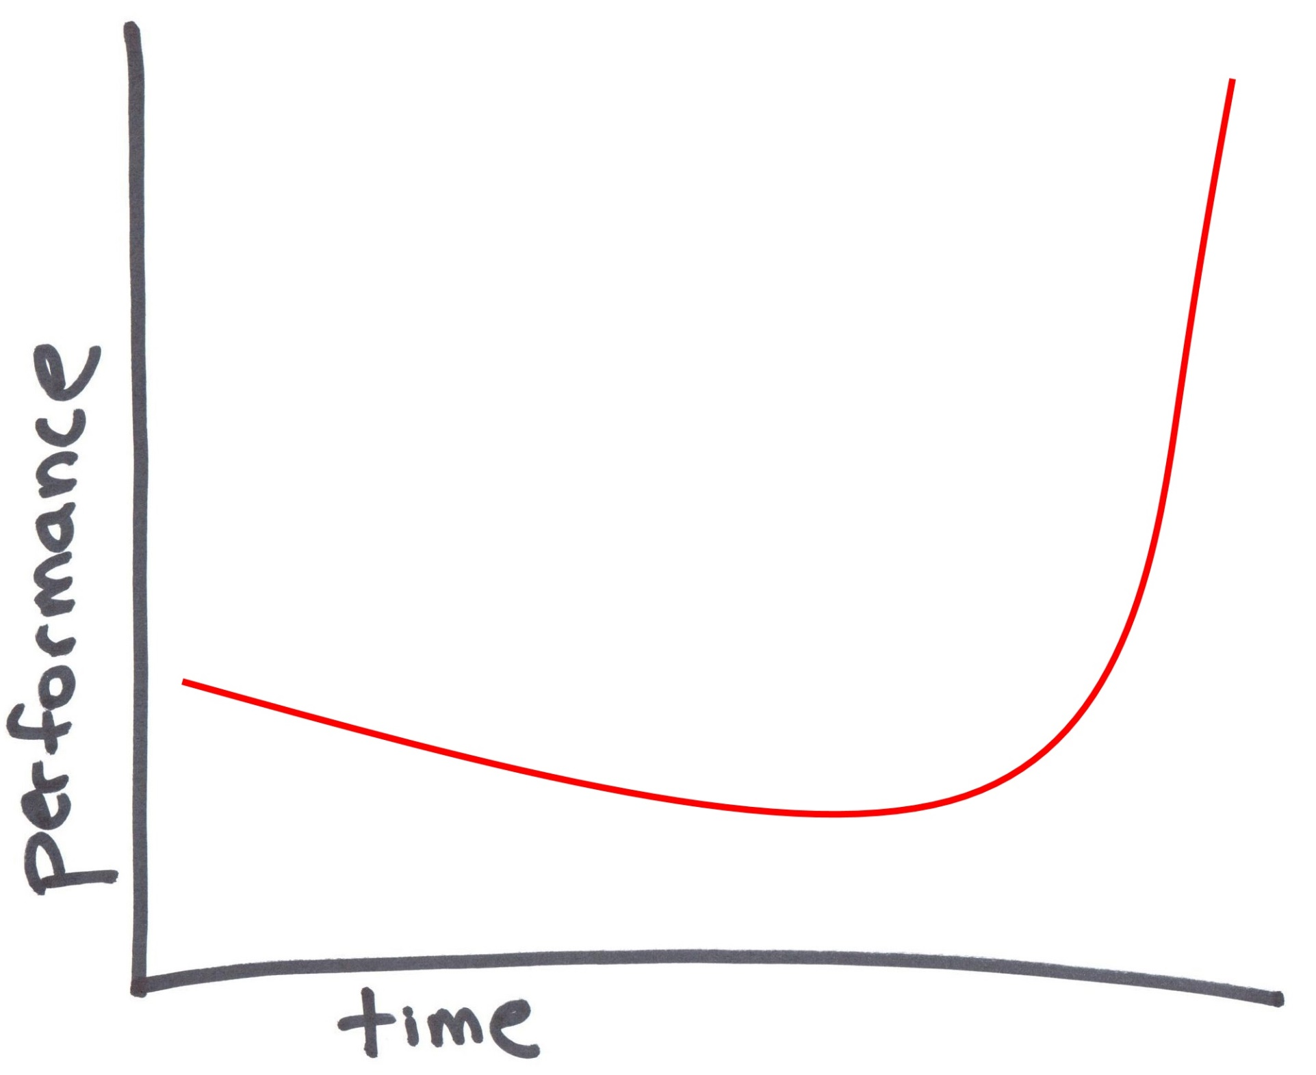

Slide 53


Slide 54
Time and Exposure

Slide 55
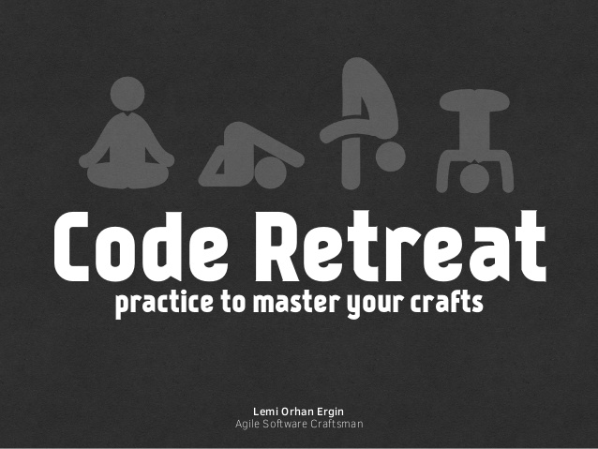

Slide 56


Slide 57
Test Driven Development, Behaviour Driven Development, Continuous Integration, Immunization, Common Coding Style, Automated Acceptance Testing, Pair Programming, Mob Programming, Code Reviews, Feature Toggles, Simple Design, Continuous Deployment, Effective Version Control, Keystoning, Refactoring

Slide 58
Find your own pattern…

Slide 59
Create Slack, learn new things Identify bottlenecks and practices Be strategic, soldier the dips Improvement part of daily process

Slide 60


Slide 61

Giving you the confidence to speed up

Slide 62

Feedback:
@MarkPearlCoZa
MarkPearl@gmail.com
Notes:
6262

